Slide 1
Spatiotemporal modelling & automated in-situ sensors to monitor Harmful Algal Blooms(HABs) Case Study-Lake Victoria
Presenter:
Name: OKELLO, JACOB OKOMO
Reg. No: ENC222-0149/2017

Slide 2
Introduction
Toxic Cyanobacteria-rich Harmful Algal Blooms (CyanoHABs) , a phenomenon in which the water body e.g. lakes turns dark blue-green due to excessive algal growth; potentially harming humans and animal, e.g., Unsightly nuisance, acute liver damage when ingested, irritation, massive fish deaths, etc.
- WHO
Hence, quantifying the spatial distributions of CyanoHABs in L. Victoria on a regular basis is of great significance, which requires high spatiotemporal resolution monitoring abilities- (Sitoki et al., 2012)
There however exists that niche to support the space observations with a near-real time geointelligent in-situ monitoring and reporting system.

Slide 3
Problem statement
The rapidly escalating demographics along L. Victoria riparian reserves has negatively impacted water quality through deposits of agricultural, industrial runoff and sewer refuse eutrophicating the said region. (Burkholder et al., 2006; MOH)
Deterioration in water quality initiates ecosystem conflicts, poor economic growth, reduced tourism, poor water quality furthermore baring achievement of SDG 6 & 14- Clean Water and Sanitation.
Coupling wide spread spatiotemporal monitoring, and automated in-situ sensors will play a big deal in return. This would inform the Govt. and the general public the affected zones, calling for immediate remedy actions.

Slide 4
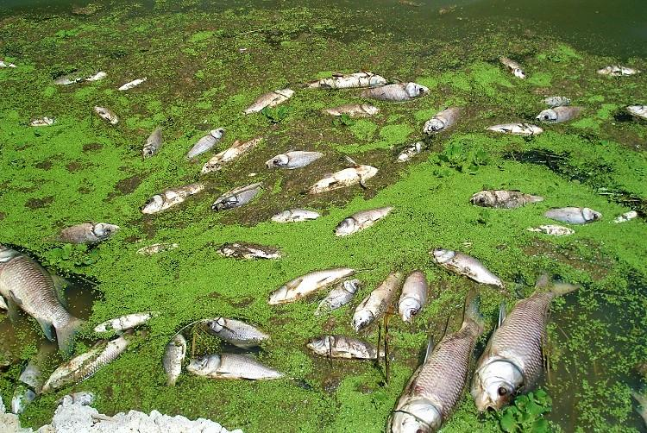
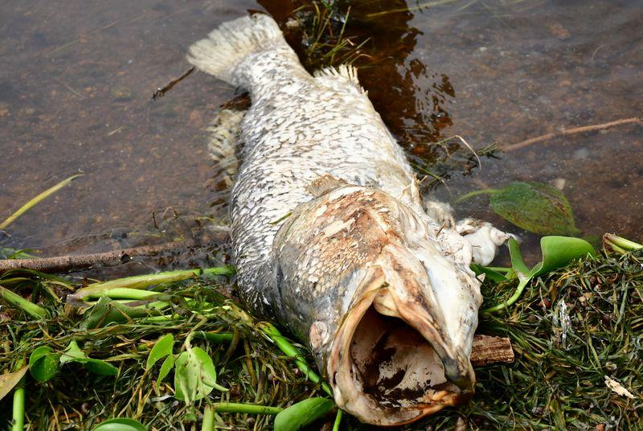
Justification
Image Source: Courtesy

Slide 5
General and specific objectives
To monitor and report the occurrence of Harmful Algal Blooms(HABs) and Cyanobacteria in Lake Victoria.
To monitor chlorophyl-a(chl-a) concentration & Cyanotoxins from L8 OLI images.
To monitor Lake Surface Water Temperature(LSWT) from L8 TIRS images as another HAB indicator in L. Victoria.
To develop automated Internet of Things (IoT) in situ sensors, Applicable in near real-time to monitor and report geo-tagged Water quality data.

Slide 6
Overall Methodology : Data and Materials
Data Type | Source | Role/Use
Landsat 8 OLI (30m, 16 days) | Google Earth Engine (2015-2020) | Spatiotemporal HAB Monitoring
Landsat 8 TIR (100m, 16 days) | Google Earth Engine (2015-2020) | Lake Surface Water Temperature Monitoring(LSWT)
Meteorological Data | Kenya Marine & Fisheries Research Institute-KMFRI (2015-2020) | Water Quality assessment
Shapefiles | Geodatabase of Global Administrative areas- GADM | Delineate the Study area
In-Situ Data | In-situ Sensors 2021 Onwards | Continued In-Situ Algal Monitoring
Tool/Material | Role | Availability
Google Earth Engine (GEE) | Geocomputation & Processing | Freely Available
QGIS, R & Python | Further Analysis & Maps | Free
Microcontroller & Sensors | In-Situ data Monitoring | Local Purchase
KiCAD | Design the Schematics & basic Circuits | Free & Open source

Slide 7
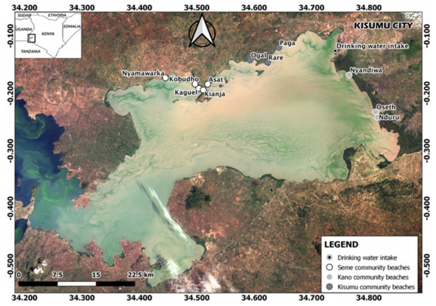
Study Area

Slide 8
Atmospheric Corrections
TIRS Data
Landsat 8 images
Geometric Corrections
OLI Data
TIRS B10
B5 NIR
B4 RED
B2 GREEN
B2 BLUE
NDVI
TOA DN to At-Sensor Radiance(Lλ)
Basic Chl-a algorithm(log₁₀)
Proportional of Vegetation(Pv)
At-Sensor Spectral Radiance to Brightness Temp (Tb₁₀)
Lake Surface Emissivity (LSE)ε
CDOM/In-situ
Estimate Lake Surface Water Temp (LSWT)
Below Threshold
Above Threshold
Spatiotemporal Monitoring
Process validation

Slide 9

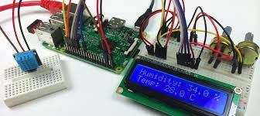


Overall methodology
Start
IoT Gateway
Ensure a secure connection via SSh
Upload in-situ data to reporter
Upload in-situ data to Processor
GPS
LWST
LSAT
No
In-situ data > Temp. threshold

Slide 10
Expected Results
Chlorophyl-a Geographical Maps associating the occurrence of the Harmful Algal Blooms and Cyanobacteria.
Lake Surface Water Temperature(LSWT) Maps associating the presence of HABs.
Autonomous system that monitors and reports geo-tagged data in near-real time the in-situ status from the sensors.

Slide 11
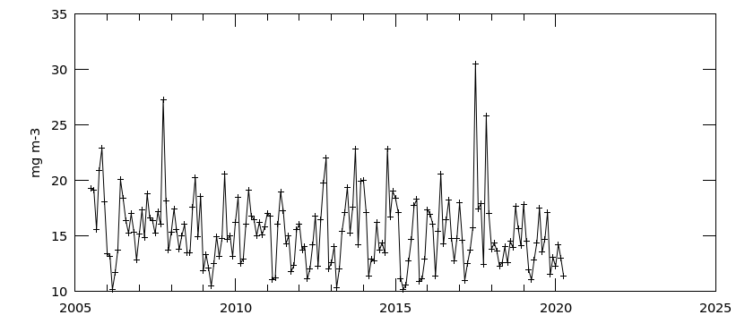
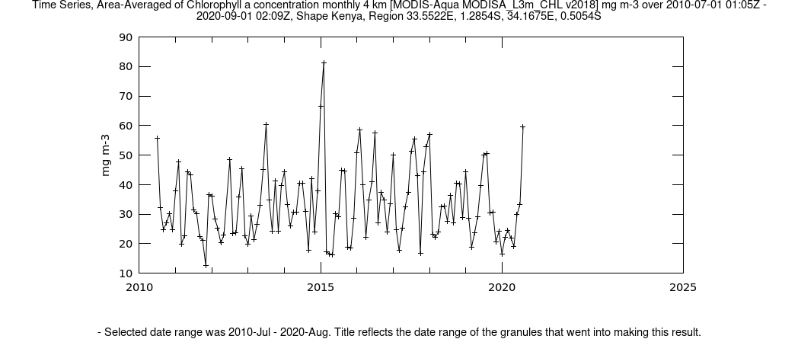
SAMPLE RESULTS: Time series Average of Chl-a conc. monthly 4-Km MODIS L3m

Slide 12
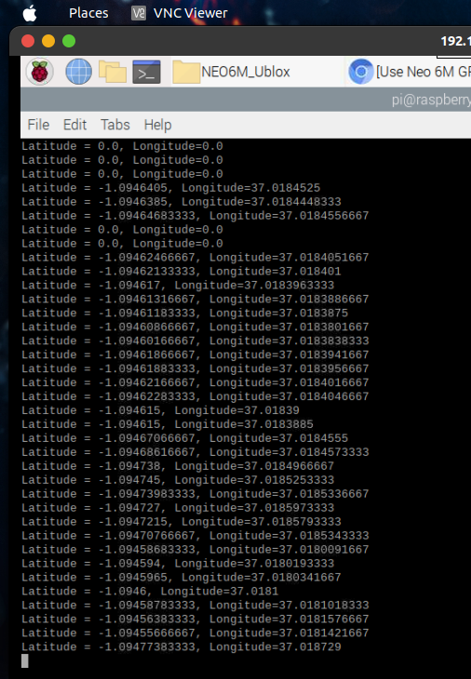
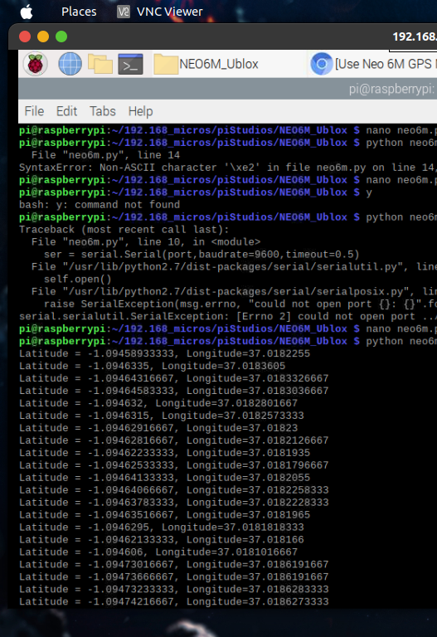
Sample Results: Obtaining GPS Location for Sensors

Slide 13

Project Timeline
 | June - July | August | Sep | Oct | Nov | Dec
Chl-a | Literature Rev (Restructure) | Data Acquisition | Chl-a spatiotemporal Maps
LSWT | Literature Rev (Restructure) |  | Chl-a spatiotemporal Maps
IoT | Literature Rev. Acquire all sensors | Unit tests | Long Range comm. |  | Full Data Acquisition

Slide 14

Thank you for your attention! Questions?

